Slide 1
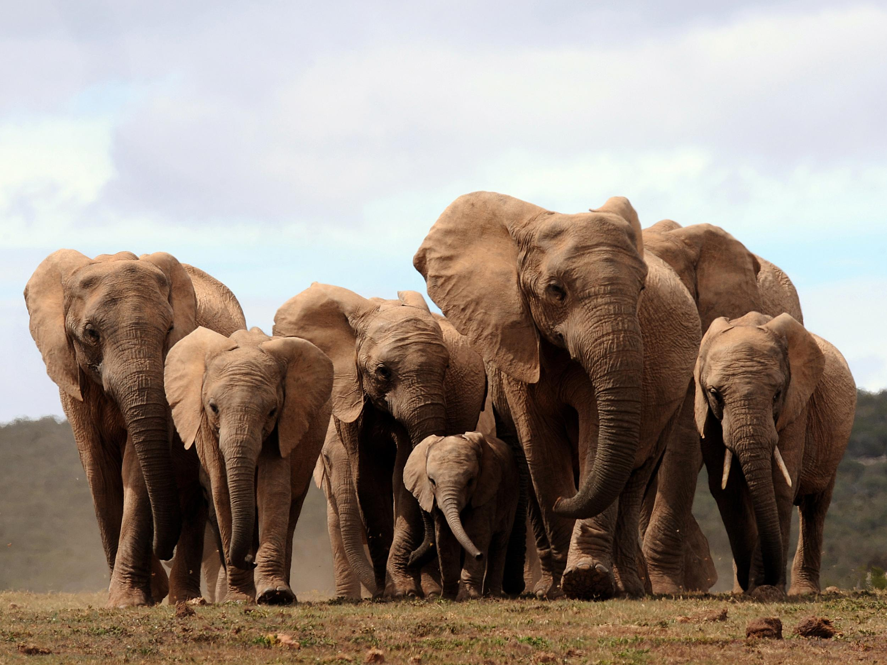

Slide 2
Data vs Information
Data :
Simply fact or figure
For example: a number 15
Information:
Context + data
For example: 15 degree centigrade is the temperature of Montreal on 8th Sept 2018 at 09:35 AM.

Slide 3
Evolution in Data management
File Based
RDBMS
Big Data
Notes:
Before moving to next slide, take a minute of pose to ask what is big data?

Slide 4
What’s Big Data?
International Data Corporation (IDC) has measured data footprint in 2013: 4.4 zettabytes
1 zettabyte = 1 billion terabytes
Forecast is to have 44 zettabytes by 2020
Where does this data come from?
Ref: Hadoop definitive guide 4th edition, Oreilly publications
Notes:
The New York Stock Exchange: 4 – 5 TB/day
Facebook hosts more than 240 billion photos, growing at 7 petabytes/month
TED talk
Pre 1993 Find Job
Trade stock
Find love
Scope of org is not just limited to managing and processing their own data, rather the success is dictated by their ability to extract value from other organization’s data

Slide 5
Characteristics of Big Data
Volume
Velocity
Variety
Value

Slide 6

Characteristic: Volume
Any guess how much amount of
data we are producing within
this room?
Connected smart cars will
generate 25GB data per hour
Ref: https://qz.com/344466/connected-cars-will-send-25-gigabytes-of-data-to-the-cloud-every-hour/

Slide 7
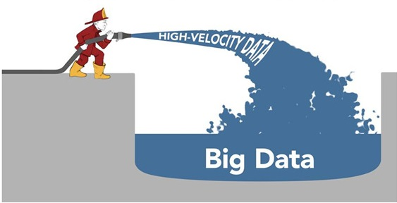
Characteristic: Velocity
What happens in an
internet second
54,907 Google searches
7,252 tweets
125,406 YouTube videos
2,501,018 emails sent
Ref: http://www.dailymail.co.uk/sciencetech/article-3662925/What-happens-internet-second-54-907-Google-searches-7-252-tweets-125-406-YouTube-video-views-2-501-018-emails-sent.html#ixzz4sNJmz06e
Notes:
54,907 Google searches
7,252 tweets
125,406 YouTube videos
2,501,018 emails sent

Slide 8

Characteristic: Variety
Structured
Semi structured
Unstructured
XML
Json
Web logs
Sensor data

Slide 9

Characteristic: Value

Slide 10
Applications
Finance
Pharma
Retail
Manufacturing
Insurance
Travel industry
Notes:
Give example of flight late and coffee message

Slide 11
Course Outline
Topics:
https://github.com/shyam-kantesariya/big_data_course/blob/master/lecture1/Topics.pdf
Email: kantesariyashyam@gmail.com
LinkedIn: https://www.linkedin.com/in/kantesariyashyam/

Slide 12
Compete to Innovate
Go to www.innovatank.com
Register as Innovator free trial
Subscribe for NASA web log analysis challenge
Make your team of two members
Choose any programming language of your choice
Submit your proposed solution
Time Limit: two hours
Notes:
Take a break now

Slide 13
What is next?
The good news is “We have big data to analyze”
But the challenge is “How to store and process it”
Notes:
Massive amount of data
Ability to structure it
Ability to find insights
Ability to deliver it to the point of view

Slide 14
What’s the solution
Build a bigger system with increased computing power
“In pioneer days they used oxen for heavy pulling, and when one ox couldn’t budge a log, they didn’t try to grow a larger ox. We shouldn’t be trying for bigger computers, but for more systems of computers” – Grace Hopper

Slide 15
Storage Technology
1990 1370 MB data 4.4 MB/s
Today TB is the norm 100 MB/s
Notes:
1990: Can read whole drive in five minutes
Today: More than two and half hours to read whole data
Solution is to have 100 drives each storing hundredth of data, then read time is under two minutes
That’s what motivated us to think of parallelism
Lets look at various computing platforms

Slide 16
Grid computing
Based on Message Passing Interface (MPI)
Uses shared filesystem
Programmer has to think at task level as opposed to data level
Missing abstraction of fault tolerance

Slide 17
Volunteer computing
System is highly compute intensive
Small amount of data on remote machine
Low bandwidth
Based on Internet
Notes:
SETI@Home is one of the example: sends 0.35 MB of radio telescope data and takes hours or days to analyze it on a typical home computer

Slide 18

Distributed Computing
Notes:
Broadly approach is to distribute work across cluster machines
Shared filesystem becomes bottleneck for storage intensive processes
Hadoop has shared nothing architecture
Hadoop has notion of data locality. Map job to the node which has that data locally
Volunteer is not safe for private data

Slide 19
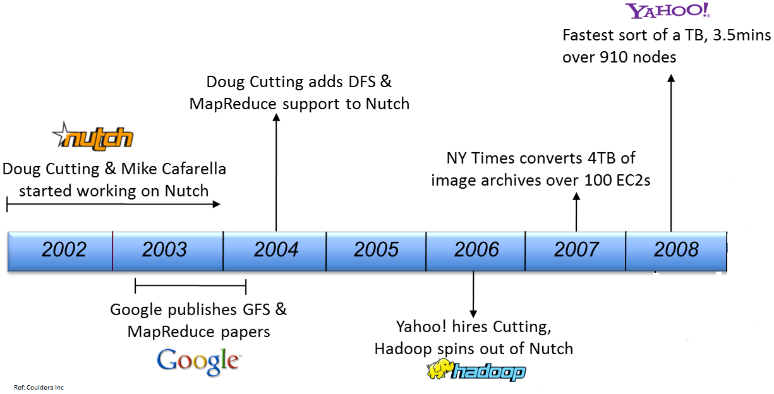
History of Hadoop

Slide 20


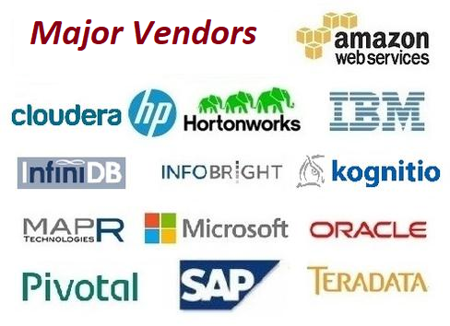




Slide 21
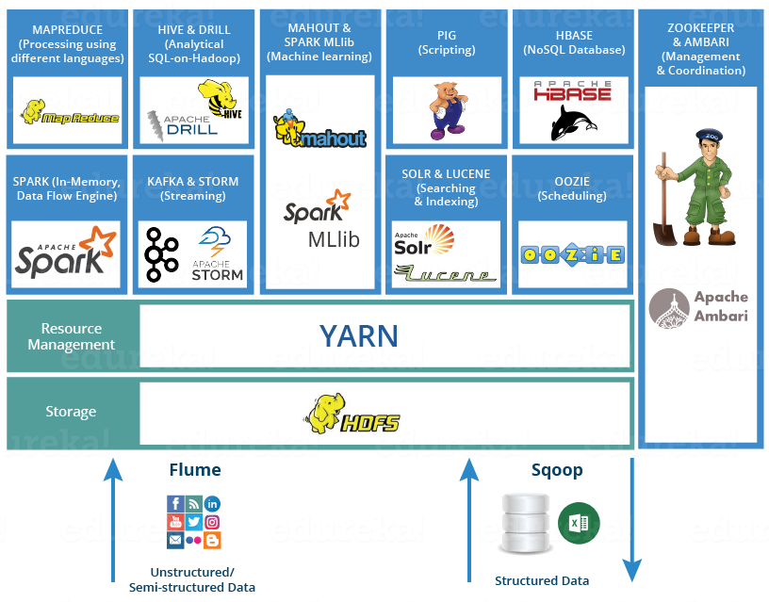
https://www.edureka.co/blog/hadoop-ecosystem

Slide 22
Major Components
HDFS
Namenode
Data node
Job Tracker
Task Tracker

Slide 23
RDBMS vs Hadoop
Attribute | RDBMS | Hadoop
Data Size | Gigabytes | Petabytes
Access | Interactive & Batch | Batch
Updates | Multiple Read/Write | Write once, Read multiple times
Transaction | ACID | None
Structure | Schema-on-write | Schema-on-read
Integrity | High | Low
Scaling | Nonlinear | Linear
Notes:
RDBMS: Data is normalized
Hadoop: flat structure
Question: Do you think Hadoop will replace RDBMS one day? Think

Slide 24
Resources
Intellij Idea
https://www.jetbrains.com/idea/download/#section=windows
Git bash
https://git-scm.com/downloads
Unix
http://www.ee.surrey.ac.uk/Teaching/Unix/

